Slide 1
Deep Learning 101
W.Ślusarczyk , M. Nowicki, M.Ostachowski,

Slide 2
Why ANN?
What’s ANN?
Task
Gradient descent
Backpropagation
Deep Learning
Pros and Cons
Further read
Exercise :
Iris with Keras
Wine for you

Slide 3
Why ANN?
Why ANN?
What’s the fuss?

Slide 4
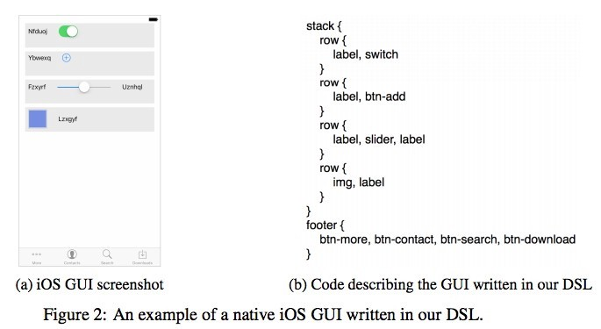
Code generator
Why ANN?
UIzard Technologies NN generate code from a single input image with over 77% of accuracy for three different platforms (i.e. iOS, Android and web-based technologies).

Slide 5
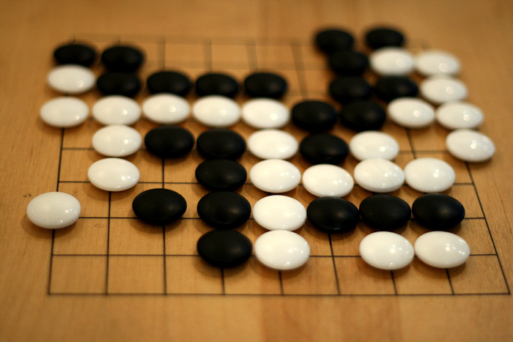
AlphaGo from DeepMind
Why ANN?
First computer program to deafeat profesional go player.
Currently computers suppressed humans

Slide 6

DeepFake
Why ANN?
Face swapping on vidoes.
https://www.youtube.com/watch?v=AQvCmQFScMA#t=20s

Slide 7

Datacenter cooling
Why ANN?
Google’s DeepMind
Lowered energy consuption by about 30%

Slide 8
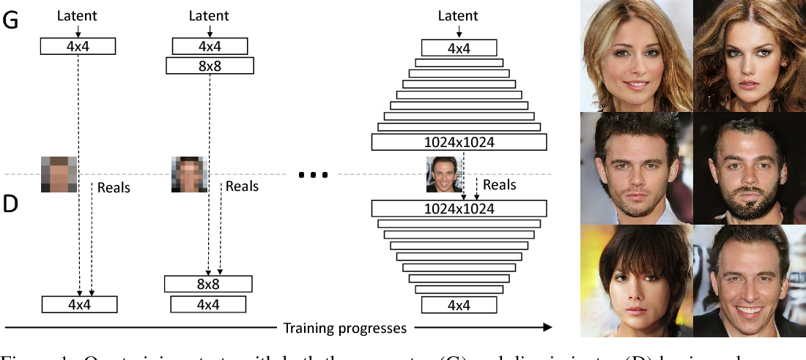
Image generation
Why ANN?
nvidia using generative adversarial networks

Slide 9


Natural language processing
Why ANN?
Google duplex – having a real-world conversation over phone
Duplex scheduling a hair salon appointment:

Slide 10
What’s ANN?
What’s ANN?
What all this about?

Slide 11
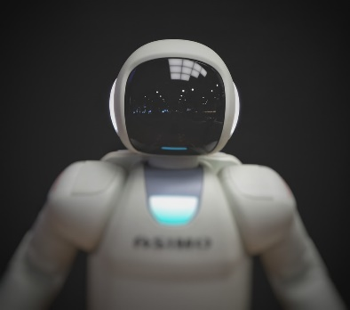
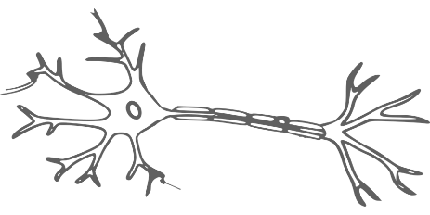
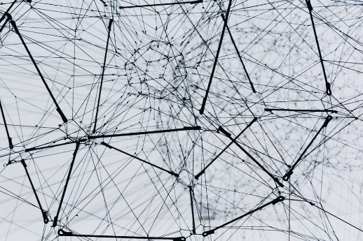
ANN - Artificial neural network
What’s ANN?
Artificial
Neural
Consist of neurons
Biological brain inspiration
Network
Connections
Imuls flow
Influence

Slide 12
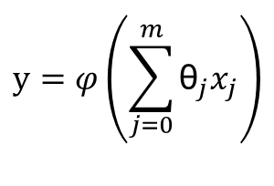
Neuron
What’s ANN?
inputs
weights
x1
sum
activation function
θ1
∑ φ
output
x2
θ2
y
θ3
x3
$$y=φ\left(\sum_{j=0}^{m}{{\text{θ}}_{j}x_{j}}\right)$$
θ0
threshold/bias
1

Slide 13
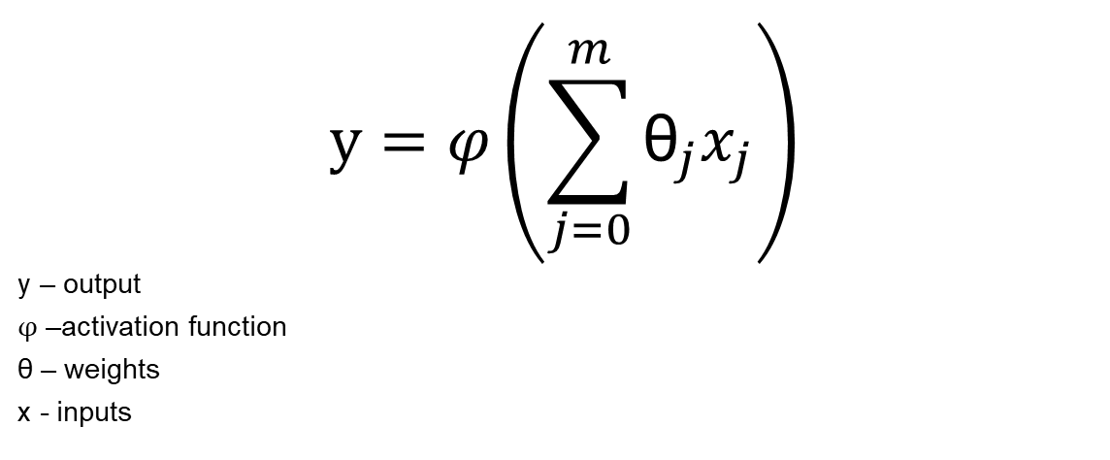
Neuron
What’s ANN?
$$y=φ\left(\sum_{j=0}^{m}{{\text{θ}}_{j}x_{j}}\right)$$
y – output
$φ$ –activation function
θ – weights
x - inputs

Slide 14
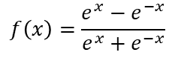
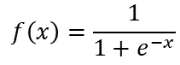
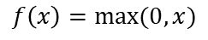
Activation function
What’s ANN?
Tanh
Sigmoid
Relu
$$f\left(x\right)=\frac{e^{x}−e^{−x}}{e^{x}+e^{−x}}$$
$$f\left(x\right)=\frac{1}{1+e^{−x}}$$
$$f\left(x\right)=max⁡(0,x)$$

Slide 15
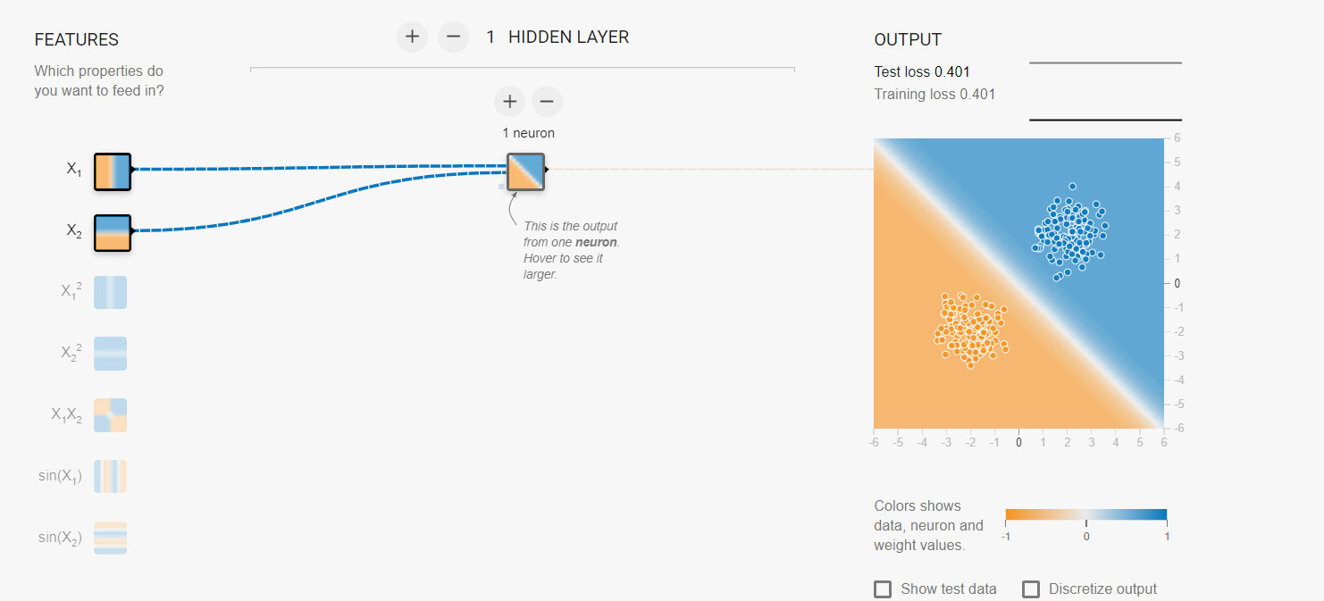
Practice
What’s ANN?
playground.tensorflow.org
https://playground.tensorflow.org/#activation=tanh&batchSize=10&dataset=gauss&regDataset=reg-plane&learningRate=0.03&regularizationRate=0&noise=0&networkShape=1&seed=0.64578&showTestData=false&discretize=false&percTrainData=50&x=true&y=true&xTimesY=false&xSquared=false&ySquared=false&cosX=false&sinX=false&cosY=false&sinY=false&collectStats=false&problem=classification&initZero=false&hideText=false

Slide 16
Neural Network
What’s ANN?
input layer
hidden layer 1
hidden layer 2
output
layer
1
threshold/bias

Slide 17
Neural Network
What’s ANN?
input layer
hidden layer 1
hidden layer 2
output
layer

Slide 18
Neural Network Architecture
What’s ANN?
Number of neurons in input/output layer are mostly dictated by solved problem
Number of layers, neurons in layers as well as activation functions can be adjasted
Another thing to tinker are meta parameters
By convience usually each layer is fully contected to previous one and all neurons in single layer have common activation function
One can easily imagine network created with diffrent rules
input layer
hidden layer 1
hidden layer 2
output
layer

Slide 19
Neural network types
What’s ANN?
Feedforward
Recurrent
Convolutional
Self organizing map

Slide 20
Math practice – forward propagation [shorter]
What’s ANN?
1
12
-30
-5
1
-9
0
3
3
10
-1
2
4
-9
1.5
2
4
4
𝜑-relu => max⁡(0,𝑥)

Slide 21
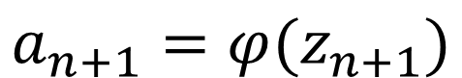
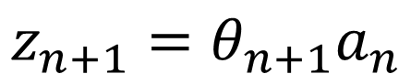
Forward propagation – simple matrix multiplication
What’s ANN?
1
$$z_{n+1}=θ_{n+1}a_{n}$$
w=[0, 2, -1, 2]
w=[-30, 1, 1]
w=[-5, 10, 2]
0.5
12
12
0
-9
3
3
$$a_{n+1}=φ(z_{n+1})$$
-3
4
4
9
9
4
w=[2.95, 1.5, 0.3, 2]
w=[-0.5, 1.5, -1.5]
Φ-relu
Can be done for multiple items simultaneously!

Slide 22
Practice
What’s ANN?
playground.tensorflow.org
https://playground.tensorflow.org/#activation=tanh&batchSize=10&dataset=xor&regDataset=reg-plane&learningRate=0.03&regularizationRate=0&noise=0&networkShape=2,1&seed=0.31451&showTestData=false&discretize=false&percTrainData=50&x=true&y=true&xTimesY=false&xSquared=false&ySquared=false&cosX=false&sinX=false&cosY=false&sinY=false&collectStats=false&problem=classification&initZero=false&hideText=false

Slide 23
Task
Task
What are we trying to solve

Slide 24
Types of Machine Learning
Task
Supervised learning
Clasification – is it spam or no spam?
Regression – how much will it cost tomorrow?
Requires labeled data for training
Unsupervised Learning
Clustering – how to split data into separate sets? (used in i.a. anomaly detecion)
Semi-supervised Learning
A mix of above
Unlabeled data with little labeled data
Reinforcement Learning
Learn how to act in given environment – learn to play all atari games

Slide 25
Types of Machine Learning
Task
Supervised learning
Clasification – is it spam or no spam?
Regression – how much will it cost tomorrow?
Requires labeled data for training
Unsupervised Learning
Clustering – how to split data into separate sets? (used in i.a. anomaly detecion)
Semi-supervised Learning
A mix of above
Unlabeled data with little labeled data
Reinforcement Learning
Learn how to act in given environment – learn to play all atari games
Neural networks

Slide 26


Supervised learning – teaching example
Task
!
Present training example
Model clasifies the example
Give model correct label
Model calculates error (▲-■)
Model learns based on error
Repeat for each training example
Repeat for certain number of epochs
?

Slide 27
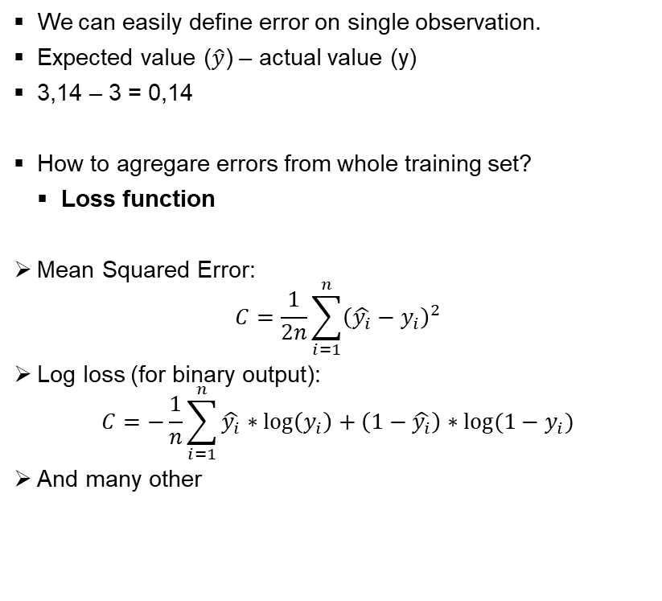
Loss function
Task
We can easily define error on single observation.
Expected value ($\hat{y}$) – actual value (y)
3,14 – 3 = 0,14
How to agregare errors from whole training set?
Loss function
Mean Squared Error:
$$C=\frac{1}{2n}\sum_{i=1}^{n}{{\left(\hat{y_{i}}−y_{i}\right)}^{2}}$$
Log loss (for binary output):
$$C=−\frac{1}{n}\sum_{i=1}^{n}{\hat{y_{i}}∗\log\left(y_{i}\right)+\left(1−\hat{y_{i}}\right)∗log⁡(1−y_{i})}$$
And many other
3,14!
3?
1
w=[0, 2, -1, 2]
w=[-30, 1, 1]
w=[-5, 10, 2]
0.5
3
-3
4
w=[2.95, 1.5, 0.3, 2]
w=[-0.5, 1.5, -1.5]
Φ-relu
Input

Slide 28
What can be adjusted?
Task
What params can be changed to alter NN behaviour? (learning)
1
Input is given
w=[0, 2, -1, 2]
w=[-30, 1, 1]
w=[-5, 10, 2]
Output should be adjusted – but indirectly
0.5
3
Changing activation function wouldn’t make much sense
Typically number of neurons and layers (nn architecture) does not change
-3
4
w=[2.95, 1.5, 0.3, 2]
w=[-0.5, 1.5, -1.5]
Neural network learns by adjusting it’s weights
Φ-relu
Input

Slide 29

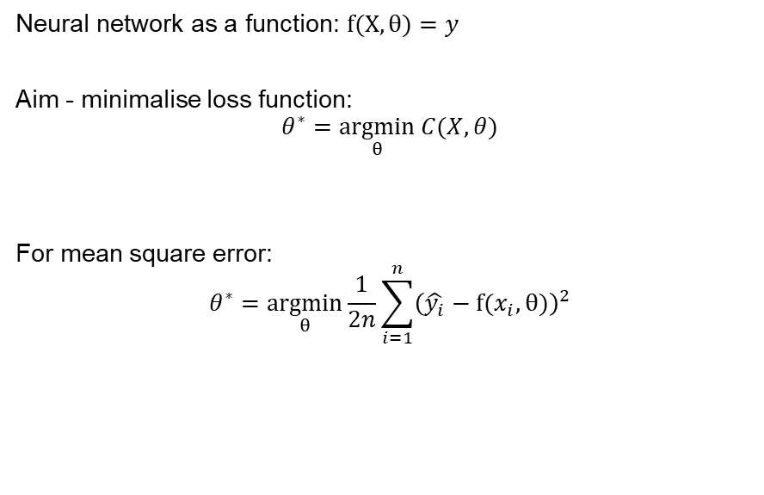
More formal problem statemant
Task
Neural network as a function: $f(X,θ)=y$
Aim - minimalise loss function:
$$θ^{∗}=\underset{θ}{argmin}{C(X,θ)}$$
For mean square error:
$$θ^{∗}=\underset{θ}{argmin}{\frac{1}{2n}\sum_{i=1}^{n}{{\left(\hat{y_{i}}−f(x_{i},θ)\right)}^{2}}}$$

Slide 30
Gradient descent
Gradient descent
Let’s start optimizing

Slide 31
Gradient descent – example
Gradient descent

Slide 32
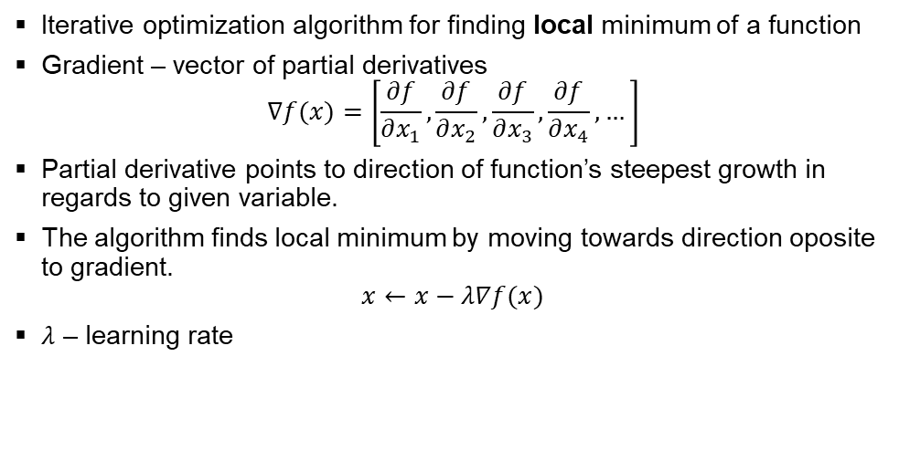
Gradient descent – what’s that?
Gradient descent
Iterative optimization algorithm for finding local minimum of a function
Gradient – vector of partial derivatives
$$∇f(x)=\left[\frac{∂f}{∂x_{1}},\frac{∂f}{∂x_{2}},\frac{∂f}{∂x_{3}},\frac{∂f}{∂x_{4}},…\right]$$
Partial derivative points to direction of function’s steepest growth in regards to given variable.
The algorithm finds local minimum by moving towards direction oposite to gradient.
$$x←x−λ∇f(x)$$
$λ$ – learning rate

Slide 33
Backpropagation
Backpropagation
The learning update

Slide 34
Backpropagation
Backpropagation
1
0.5
ERROR
-3
4

Slide 35
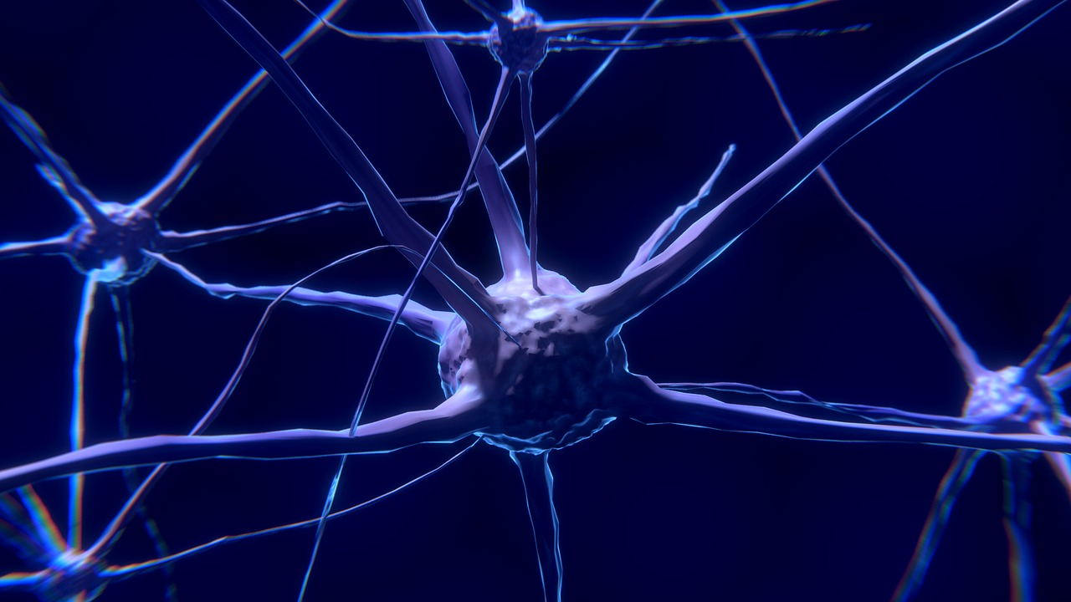
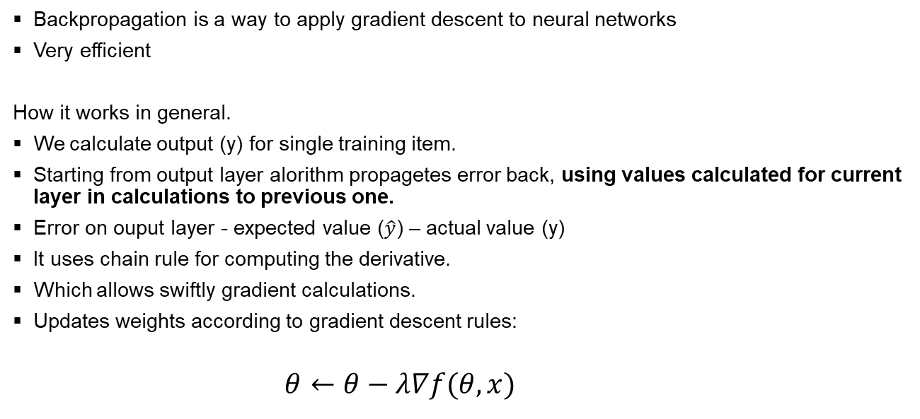
Backpropagation – what’s that?
Backpropagation
Backpropagation is a way to apply gradient descent to neural networks
Very efficient
How it works in general.
We calculate output (y) for single training item.
Starting from output layer alorithm propagetes error back, using values calculated for current layer in calculations to previous one.
Error on ouput layer - expected value ($\hat{y}$) – actual value (y)
It uses chain rule for computing the derivative.
Which allows swiftly gradient calculations.
Updates weights according to gradient descent rules:
$$θ←θ−λ∇f(θ,x)$$

Slide 36
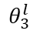
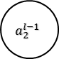
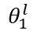
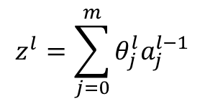
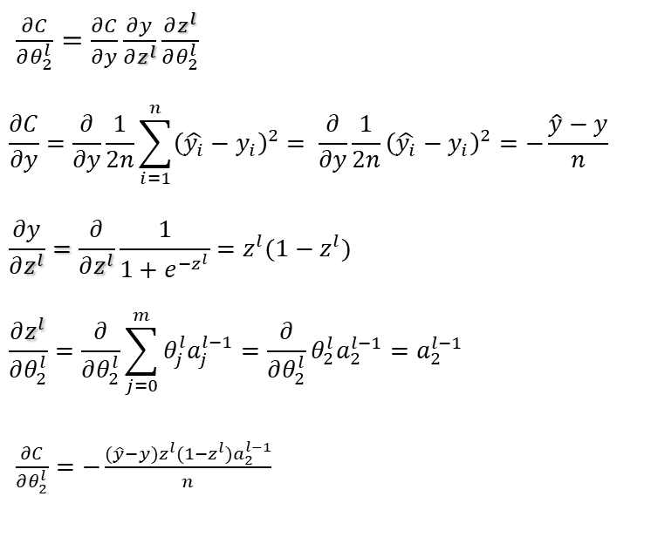

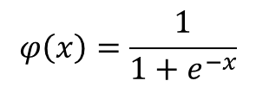
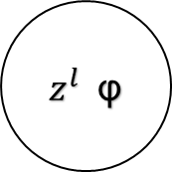
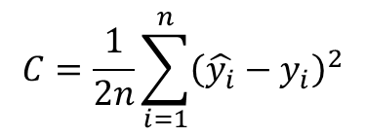

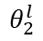
Backpropagation – output layer
Backpropagation
$$a_{1}^{l−1}$$
$$θ_{1}^{l}$$
$\frac{∂C}{∂θ_{2}^{l}}=\frac{∂C}{∂y}\frac{∂y}{∂z^{l}}\frac{∂z^{l}}{∂θ_{2}^{l}}$
$$\frac{∂C}{∂y}=\frac{∂}{∂y}\frac{1}{2n}\sum_{i=1}^{n}{{\left(\hat{y_{i}}−y_{i}\right)}^{2}}= \frac{∂}{∂y}\frac{1}{2n}{\left(\hat{y_{i}}−y_{i}\right)}^{2}=−\frac{\hat{y}−y}{n}$$
$$\frac{∂y}{∂z^{l}}=\frac{∂}{∂z^{l}}\frac{1}{1+e^{−z^{l}}}=z^{l}(1−z^{l})$$
$$\frac{∂z^{l}}{∂θ_{2}^{l}}=\frac{∂}{∂θ_{2}^{l}}\sum_{j=0}^{m}{θ_{j}^{l}a_{j}^{l−1}}=\frac{∂}{∂θ_{2}^{l}}θ_{2}^{l}a_{2}^{l−1}=a_{2}^{l−1}$$
$\frac{∂C}{∂θ_{2}^{l}}=−\frac{(\hat{y}−y)z^{l}(1−z^{l})a_{2}^{l−1}}{n}$
$z^{l}$φ
$$a_{2}^{l−1}$$
$$θ_{2}^{l}$$
y
$$a_{3}^{l−1}$$
$$θ_{3}^{l}$$
$$C=\frac{1}{2n}\sum_{i=1}^{n}{{\left(\hat{y_{i}}−y_{i}\right)}^{2}}$$
$$φ\left(x\right)=\frac{1}{1+e^{−x}}$$
$$z^{l}=\sum_{j=0}^{m}{θ_{j}^{l}a_{j}^{l−1}}$$

Slide 37
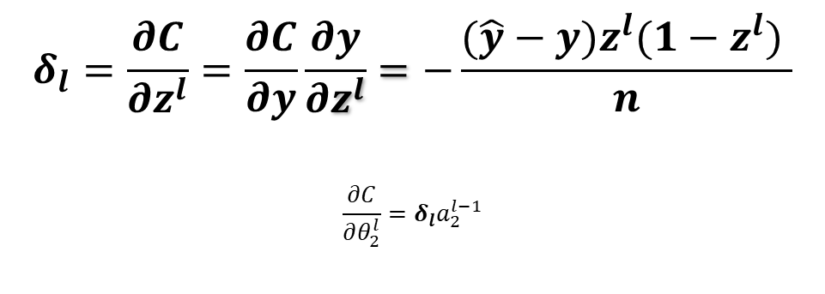
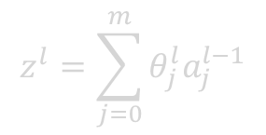
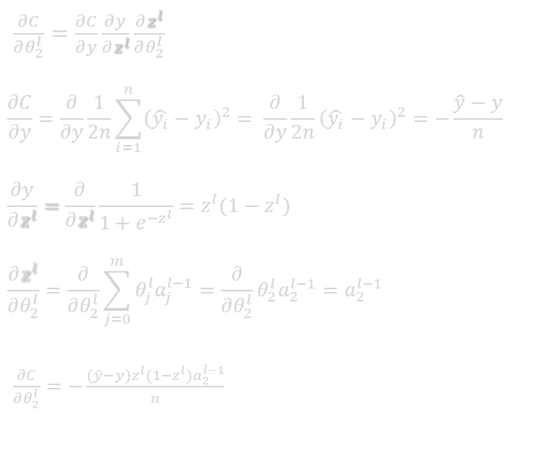
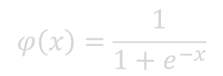
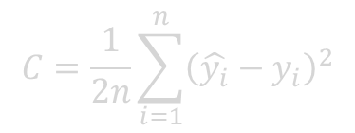
Backpropagation – delta
Backpropagation
$$a_{1}^{l−1}$$
$$θ_{1}^{l}$$
$\frac{∂C}{∂θ_{2}^{l}}=\frac{∂C}{∂y}\frac{∂y}{∂z^{l}}\frac{∂z^{l}}{∂θ_{2}^{l}}$
$$\frac{∂C}{∂y}=\frac{∂}{∂y}\frac{1}{2n}\sum_{i=1}^{n}{{\left(\hat{y_{i}}−y_{i}\right)}^{2}}= \frac{∂}{∂y}\frac{1}{2n}{\left(\hat{y_{i}}−y_{i}\right)}^{2}=−\frac{\hat{y}−y}{n}$$
$$\frac{∂y}{∂z^{l}}=\frac{∂}{∂z^{l}}\frac{1}{1+e^{−z^{l}}}=z^{l}(1−z^{l})$$
$$\frac{∂z^{l}}{∂θ_{2}^{l}}=\frac{∂}{∂θ_{2}^{l}}\sum_{j=0}^{m}{θ_{j}^{l}a_{j}^{l−1}}=\frac{∂}{∂θ_{2}^{l}}θ_{2}^{l}a_{2}^{l−1}=a_{2}^{l−1}$$
$\frac{∂C}{∂θ_{2}^{l}}=−\frac{(\hat{y}−y)z^{l}(1−z^{l})a_{2}^{l−1}}{n}$
$z^{l}$φ
$$a_{2}^{l−1}$$
$$θ_{2}^{l}$$
y
$$a_{3}^{l−1}$$
$$θ_{3}^{l}$$
$$δ_{l}=\frac{∂C}{∂z^{l}}=\frac{∂C}{∂y}\frac{∂y}{∂z^{l}}=−\frac{(\hat{y}−y)z^{l}(1−z^{l}) }{n}$$
$$\frac{∂C}{∂θ_{2}^{l}}=δ_{l}a_{2}^{l−1}$$
$$C=\frac{1}{2n}\sum_{i=1}^{n}{{\left(\hat{y_{i}}−y_{i}\right)}^{2}}$$
$$φ\left(x\right)=\frac{1}{1+e^{−x}}$$
$$z^{l}=\sum_{j=0}^{m}{θ_{j}^{l}a_{j}^{l−1}}$$

Slide 38
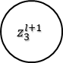
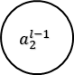
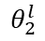
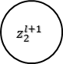
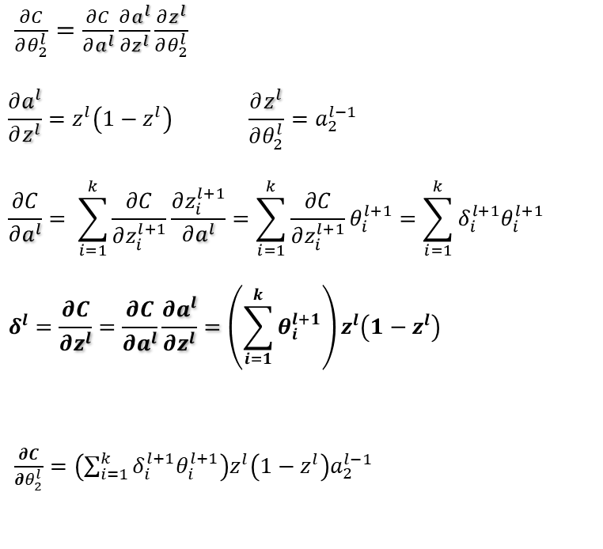
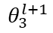
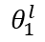
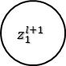

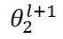
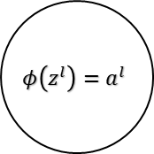
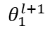
Backpropagation – earlier layers
Backpropagation
$$a_{1}^{l−1}$$
$$z_{1}^{l+1}$$
$$θ_{1}^{l}$$
$$θ_{1}^{l+1}$$
$$φ\left(z^{l}\right)=a^{l}$$
$\frac{∂C}{∂θ_{2}^{l}}=\frac{∂C}{∂a^{l}}\frac{∂a^{l}}{∂z^{l}}\frac{∂z^{l}}{∂θ_{2}^{l}}$
$$\frac{∂a^{l}}{∂z^{l}}=z^{l}\left(1−z^{l}\right) \frac{∂z^{l}}{∂θ_{2}^{l}}=a_{2}^{l−1}$$
$$\frac{∂C}{∂a^{l}}= \sum_{i=1}^{k}{\frac{∂C}{∂z_{i}^{l+1}}}\frac{∂z_{i}^{l+1}}{∂a^{l}}=\sum_{i=1}^{k}{\frac{∂C}{∂z_{i}^{l+1}}θ_{i}^{l+1}}=\sum_{i=1}^{k}{{δ_{i}^{l+1}θ}_{i}^{l+1}}$$
$$δ^{l}=\frac{∂C}{∂z^{l}}=\frac{∂C}{∂a^{l}}\frac{∂a^{l}}{∂z^{l}}=\left(\sum_{i=1}^{k}{θ_{i}^{l+1}}\right)z^{l}\left(1−z^{l}\right)$$
$\frac{∂C}{∂θ_{2}^{l}}=\left(\sum_{i=1}^{k}{{δ_{i}^{l+1}θ}_{i}^{l+1}}\right)z^{l}\left(1−z^{l}\right)a_{2}^{l−1}$
$$a_{2}^{l−1}$$
$$θ_{2}^{l}$$
$$z_{2}^{l+1}$$
$$θ_{2}^{l+1}$$
$$θ_{3}^{l+1}$$
$$z_{3}^{l+1}$$
$$C=\frac{1}{2n}\sum_{i=1}^{n}{{\left(\hat{y_{i}}−y_{i}\right)}^{2}}$$
$$φ\left(x\right)=\frac{1}{1+e^{−x}}$$
$$z^{l}=\sum_{j=0}^{m}{θ_{j}^{l}a_{j}^{l−1}}$$

Slide 39
Deep learning
Backpropagation
More of everything

Slide 40

Deeper = More
Task
Deep learning utilizes large number of hidden layers. But no strict treshold exists.
Each layers learns higher level features.
More:
Layers
Data required
Learning time needed
Robust effective result (hopefully)

Slide 41
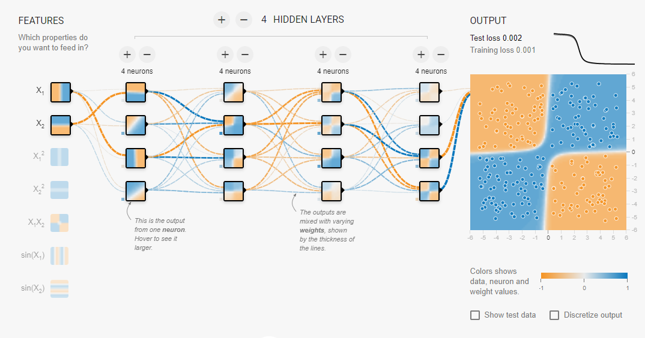
Example
Task
playground.tensorflow.org
https://playground.tensorflow.org/#activation=tanh&batchSize=10&dataset=xor&regDataset=reg-plane&learningRate=0.03&regularizationRate=0&noise=0&networkShape=4,4,4,4&seed=0.61047&showTestData=false&discretize=false&percTrainData=50&x=true&y=true&xTimesY=false&xSquared=false&ySquared=false&cosX=false&sinX=false&cosY=false&sinY=false&collectStats=false&problem=classification&initZero=false&hideText=false

Slide 42
Pros and Cons
Backpropagation
When should it be used?

Slide 43

Cons
Pros and Cons
Black box
Needs lots of labeled data
Takes long time to train
No one fit-all architecture

Slide 44

Pros
Pros and Cons
Efficient gradient descent application
Quick predictions, after training
Great performance scaling with data
Flexible
Elegant way to represent very complex models

Slide 45
Further reading
Further reading
What’s more to learn?

Slide 46
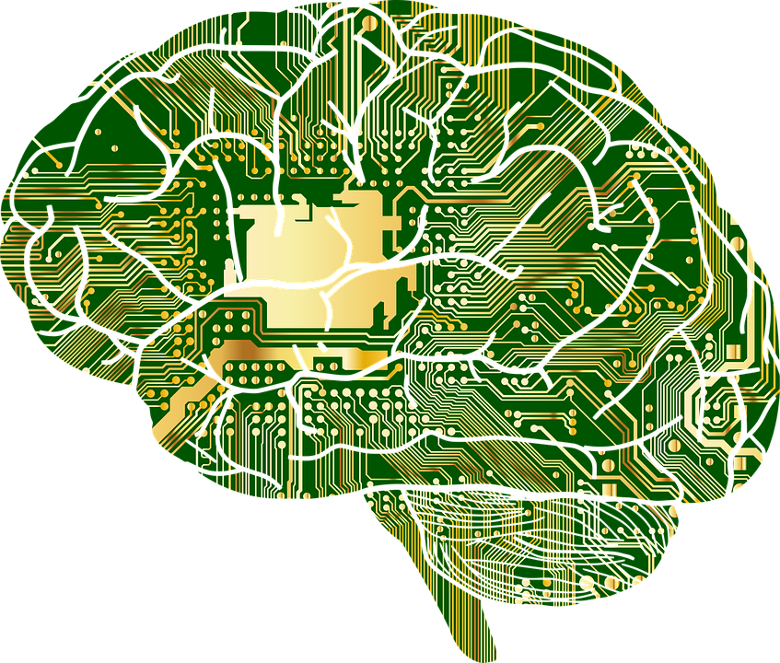
Further reading
Further reading
playground.tensorflow.org
Neural Networks and Deep Learning, by Andrew Ng
Coursera
keras.io
https://www.kaggle.com/bhasha4995dushara/pandas-exercise-1

Slide 47

The End
End
Thank you for the attention

Slide 48
Sources
End
Beltramelli, T. (2017). pix2code: Generating Code from a Graphical User Interface Screenshot. EICS.
Karras, Tero et al. “Progressive Growing of GANs for Improved Quality, Stability, and Variation.” ArXiv abs/1710.10196 (2017): n. pag.
https://en.wikipedia.org
https://skymind.ai/wiki/neural-network
https://mattmazur.com/2015/03/17/a-step-by-step-backpropagation-example/

Slide 49
Images
End
http://poznan.go.art.pl
https://pixabay.com/photos/data-center-the-engine-room-2476790/
https://pixabay.com/photos/phone-old-year-built-1955-bakelite-3594206/
https://unsplash.com/photos/JjGXjESMxOY
https://pixabay.com/vectors/brain-neuron-nerves-cell-science-2022398/
https://unsplash.com/photos/ZiQkhI7417A
https://pixabay.com/photos/child-toddler-sitting-sand-beach-871845/
https://pixabay.com/illustrations/pyramids-egypt-archeology-pharaoh-4008455/
https://pixabay.com/illustrations/nerve-cell-neuron-brain-neurons-2213009/
https://pixabay.com/vectors/button-minus-sepia-round-brown-310107/
https://pixabay.com/vectors/plus-sign-green-mark-icon-symbol-24844/
https://pixabay.com/vectors/anatomy-biology-brain-thought-mind-1751201/
https://unsplash.com/photos/XexawgzYOBc

